Slide 1
COMP 53 – Week Eight
Linked Lists

Slide 2
Topics
Review Lab 6
Linked List Concepts
Creating and Managing Lists
Doubly Linked Lists

Slide 3
Why Do We Care
More Flexible way to manage data
Can grow and shrink based on actual data being used
Can handle complex user defined data

Slide 4
Data Structures
By the way, the name of this class!!!
Data Structures
Linear
Direct Access
Sequential Access
Nonlinear
Hierarchical
Array
List
Stack
Queue
Hashtable
Tree
Heap

Slide 5


Slide 6


Slide 7


Slide 8
Introduction
Linked list
Constructed using pointers
Grows and shrinks during run-time
Doubly Linked List : A variation with pointers in both directions
Pointers are the backbone of lists
Use dynamic variables
Different from Arrays in that memory is not in one block
Standard Template Library
Has predefined versions of some structures

Slide 9
Pointer Review
int x = 10;
int y = x;
int* a = &x;
int* b = a;
int* c = &y;
5A111110
5A11111C
5A111127
5A111111
5A11111D
5A111128
5A111112
10
5A111129
y
5A111113
5A11111F
5A11112A
5A111114
5A11111F
5A11111E
c
10
5A111120
5A11112C
x
5A111116
5A111121
5A111115
a
5A111117
5A111122
5A11112E
5A111118
5A111123
5A11112F
Pointers are typed.
Ex., double* ptr;
int *p1, *p2;
5A111119
5A111124
5A111115
b
5A11111A
5A111125
5A111131
5A11111B
5A111126
5A111132

Slide 10
Pointers → Vars → Pointers
&x:
“address of x”
x is a regular var.
&x is a pointer
*p:
“what p points at” or “contents of p”
p is a pointer
*p is a regular var.

Slide 11

Nodes are the Lego Blocks
Each "node" is variable of struct or class type that’s dynamically created with new
Member variables represent data about what list is for:
Names, addresses, etc
Manufacturing items, inventory counts, costs, etc
Student test scores, ranking, etc
Nodes also contain pointers to other nodes
Provide "links"

Slide 12
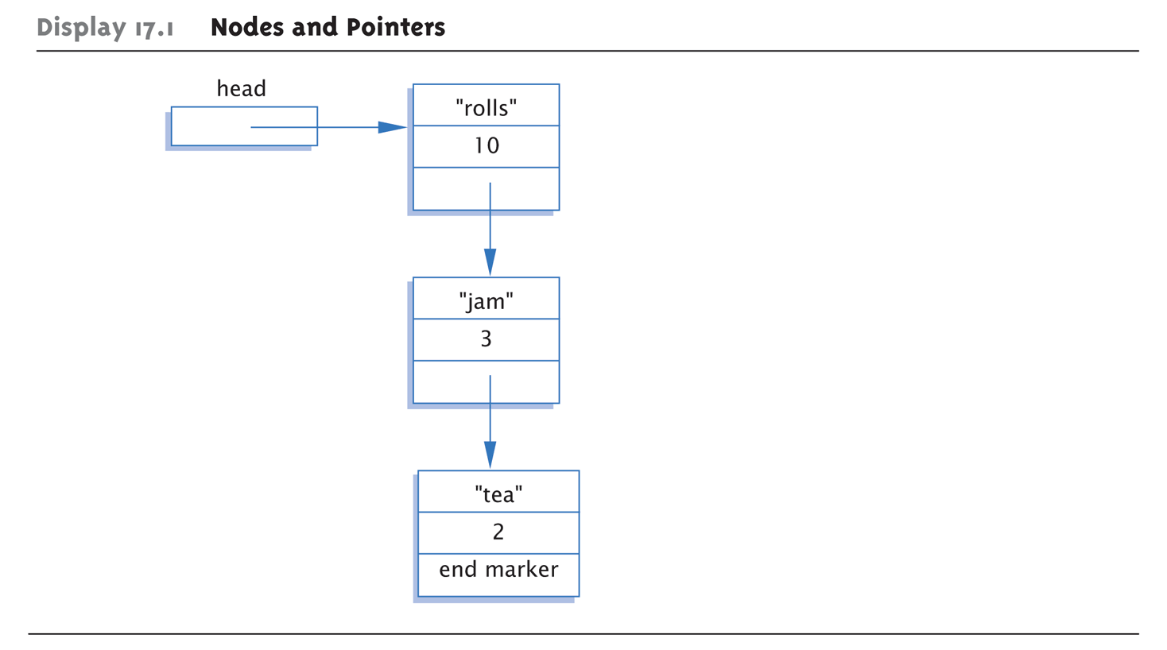

Nodes Get Linked Together

Slide 13
Arrays vs Linked List
7 | 8 | 11 | 14 | 17 | 22
[0] | [1] | [2] | [3] | [4] | [5]
Access and Loops are easier with arrays
7
8
11
14
17
22

Slide 14
Arrays vs Linked List Insert Operation
7 | 8 | 11 | 14 | 17
[0] | [1] | [2] | [3] | [4] | [5]
10
7
8
11
14
17

Slide 15
Arrays vs Linked List Insert Operation
7 | 8 | 11 | 14 | 17
[0] | [1] | [2] | [3] | [4] | [5]
10
10
7
8
11
14
17

Slide 16
Arrays vs Linked List Delete Operation
7 | 8 | 11 | 14 | 17 | 22
[0] | [1] | [2] | [3] | [4] | [5]
11
7
8
11
14
17
22

Slide 17
Arrays vs Linked List Delete Operation
7 | 8 |  | 14 | 17 | 22
[0] | [1] | [2] | [3] | [4] | [5]
7
8
11
14
17
22

Slide 18
Topics
Linked List Concepts
Creating and Managing Lists
Doubly Linked Lists

Slide 19
Basic Node Definition
class ListNode { private: string item; // or T if using templates
int count; ListNode *link; };
Variable definition: ListNode* ListNodePtr;
Also notice "circularity"

Slide 20

Head Pointer
Box labeled "head" not a node: ListNodePtr head;
A simple pointer to a node
Set to point to 1st node in list
Head used to "maintain" start of list
Assignment
head->item = "Hello ";
cin >> head->item;
Also used as argument to functions
Use NULL for node pointer. Considered "sentinel" for nodes. Indicates no further "links" after this node

Slide 21
Linked List Practice Step 1 of 4
Create new practice project
Implement the node as a template class
Define a new class for the node
Private members for T data and Node* next
Default constructor - Set link to null
General constructor
Set link to input pointer node
Set item data to input parameter data
Implement getters and setters
Main()
Must include both node.h and node.cpp
Declare Node<string> temp("Hello", NULL);
Notes:
Note – cout sometimes behaves odd with template data coming back from getData methods

Slide 22
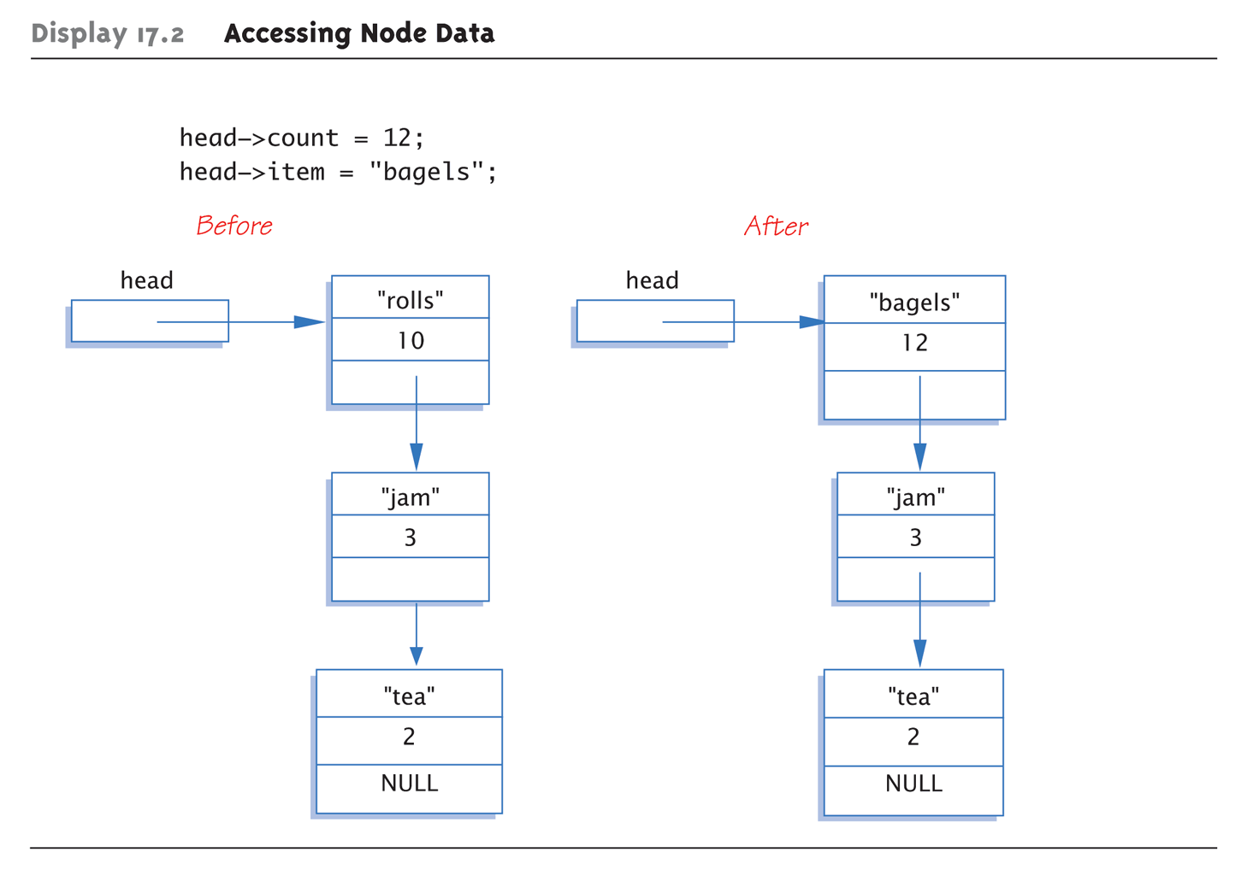
Accessing Node Data
Assumes that member variables are public

Slide 23
Linked List Class Definition Version 2
Default constructor sets link to null
class IntNode { public: IntNode() { data = 0; intNode = null; } IntNode(int theData, IntNode* theLink) : data(theData), link(theLink) { } IntNode* getLink() {return link;} int getData() {return data;} void setData(int theData) {data = theData;} void setLink(intNode* pointer) {link=pointer;} private: int data; intNode *link; }; IntNode* p1 = new IntNode;
IntNode* p2 = new IntNode(42, p1);
Remember shortcut!
General constructor allows for built in link to next in list

Slide 24
Linked List Practice Step 2 of 4
Define another class that will represent the actual list
Add private member variable which is
Node<T>* head;
Default constructor should set head to _________
General constructor should set head to input parameter
Create a print method which loops through the linked list and calls the node getData method to display value of node
In main() - LinkedList<string> list(&temp);
Then call list.print();

Slide 25
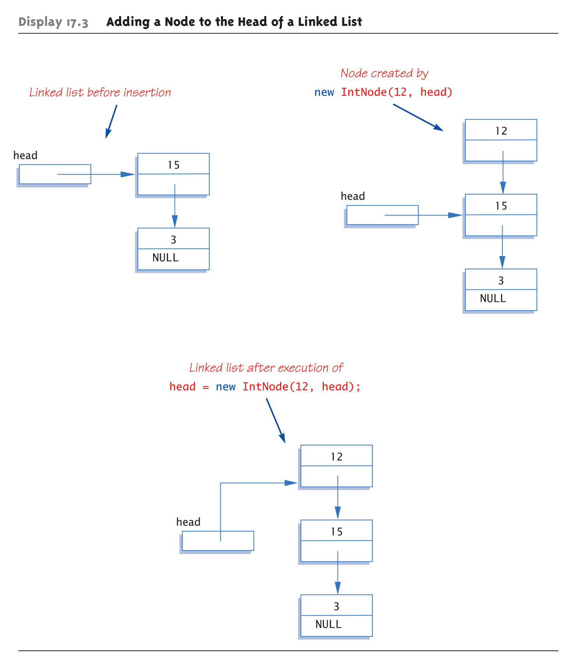

Slide 26
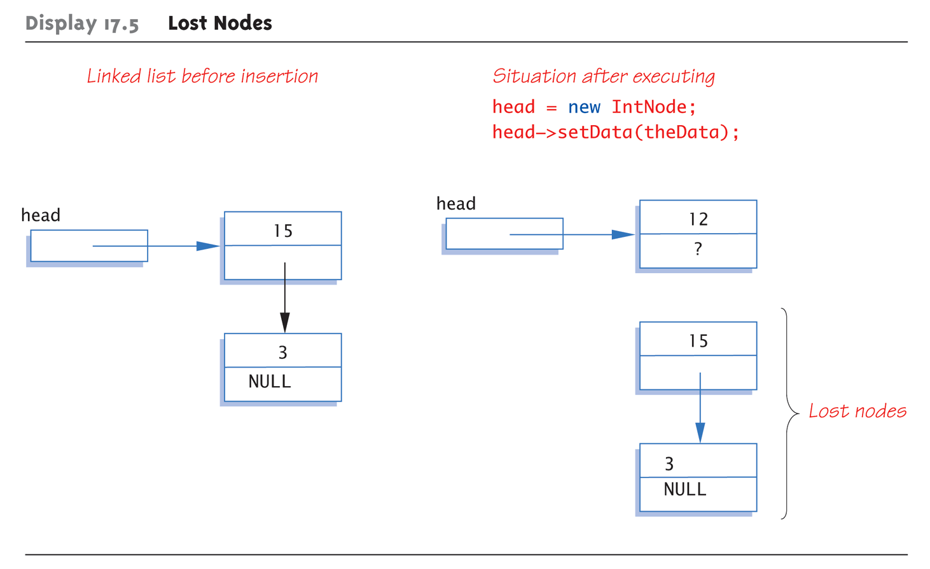
Lost Nodes Pitfall – Don’t Lose Your Head

Slide 27
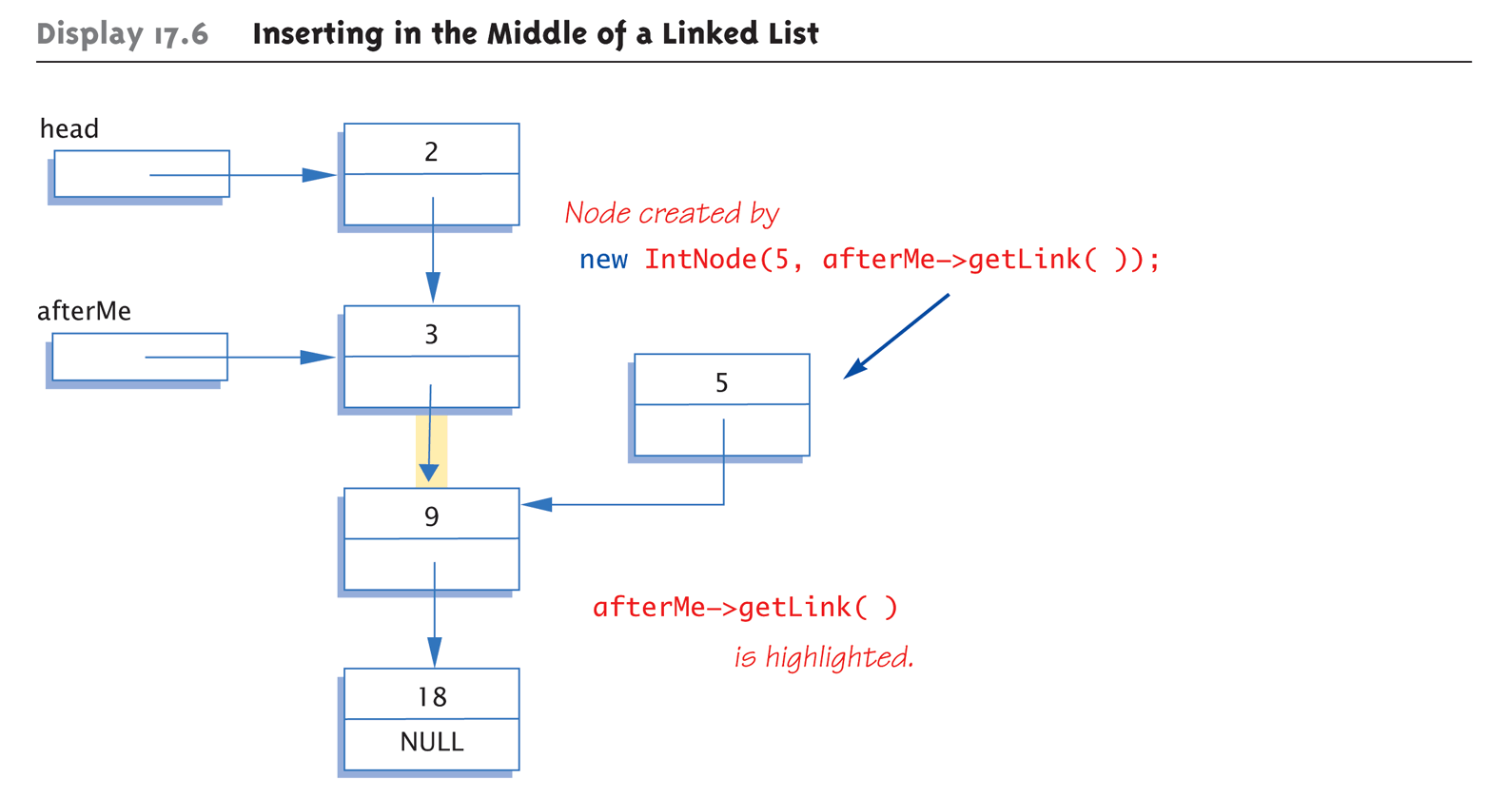
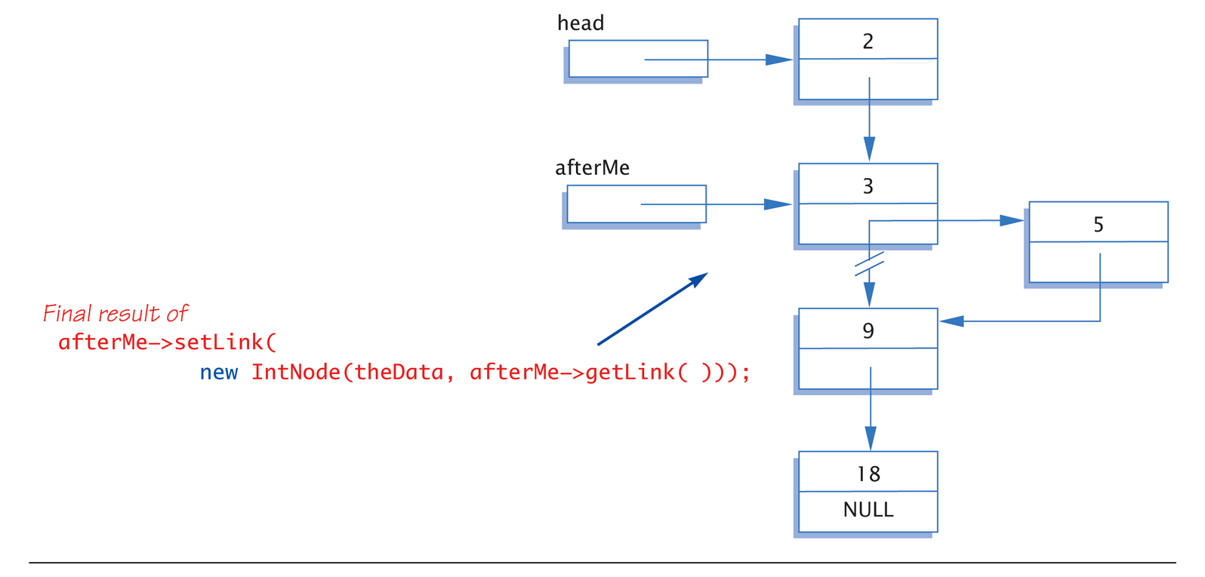
Inserting in the Middle of a Linked List

Slide 28
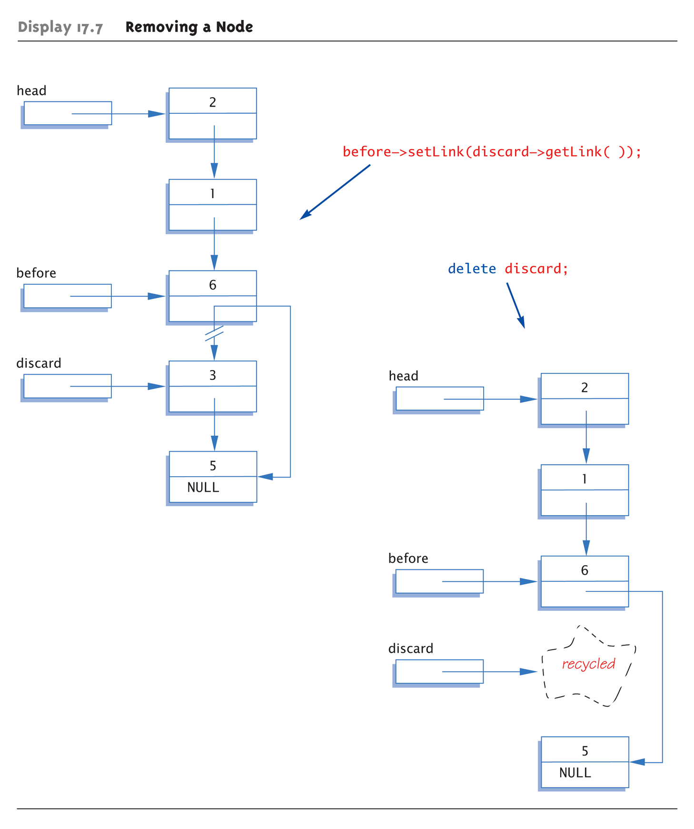

Slide 29
Linked List Practice Step 3 of 4
Write the insert method to add a new node to the linked list in sorted order
Define a function that will prepend a node to tbe beginning of the list
Node<T>* node = new Node<T>(n, NULL);
node->setNext(head);
head = node;
Next, define the insert method
If the list is empty (head == null), call prepend
If the current head of the list is smaller than the new value, call prepend
Else loop through the list until we find a node that is smaller than the new value. Create a new node and insert it into the list (see notes)
Notes:
if (head == NULL)
prepend(n);
else if (n < head->getData())
prepend(n);
else {
Node<T>* ptr = head;
while (ptr->getNext() != NULL && ptr->getNext()->getData() < n)// look ahead one node and see if that node is smaller
ptr = ptr->getNext();
Node<T>* temp = new Node<T>(n, ptr->getNext());// create the node and insert into list.
ptr->setNext(temp);
}

Slide 30
Searching for Nodes
Pseudocode:
while (current doesn’t point to target node or last node) Make current point to next node in list if (current node points to target) return current pointer else return NULL
while (cur->getData() != target
&& cur->getLink() != NULL) cur = cur->getLink(); if (cur->getData() == target) return here; else return NULL;
Notes:
Must make "special" case for empty list
Not done here

Slide 31
Linked List Practice Step 4 of 4
Write the search method
Loop through the list until you find the node that matches the data value
Return the address of the found node or NULL if not found
Write the remove method
If the list is empty, do nothing
If the head of the list matches the data value, advance the head to the next node in list
Else loop through the list until node is found. Reset pointers and delete the node.
Notes:
template<class T>
Node<T>* LinkedList<T>::search(T n)
{
Node<T>* ptr = head;
while (ptr != NULL) {
if (ptr->getData() == n)
return ptr;
ptr = ptr->getNext();
}
return NULL;
}
template<class T>
void LinkedList<T>::remove(T n)
{
if (head == NULL) return;
if (head->getData() == n) {
Node<T>* temp = head;
head = head->getNext();
delete temp;
}
else {
Node<T>* ptr = head;
while (ptr->getNext() != NULL) {
if (ptr->getNext()->getData() == n) {
Node<T>* temp = ptr->getNext();
ptr->setNext(ptr->getNext()->getNext());
delete temp;
return;
}
ptr = ptr->getNext();
}
}
}

Slide 32
Topics
Linked List Concepts
Creating and Managing Lists
Doubly Linked Lists

Slide 33
Twice the Fun!
Single is a lonely number – can only go in one direction!
Doubly Linked List
Links to the next node and another link to the previous node
Can follow links in either direction
NULL signifies the beginning and end of the list
Can make some operations easier, e.g. deletion since we don’t need to search the list to find the node before the one we want to remove

Slide 34
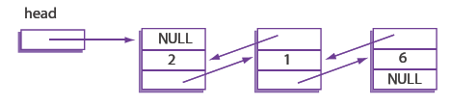
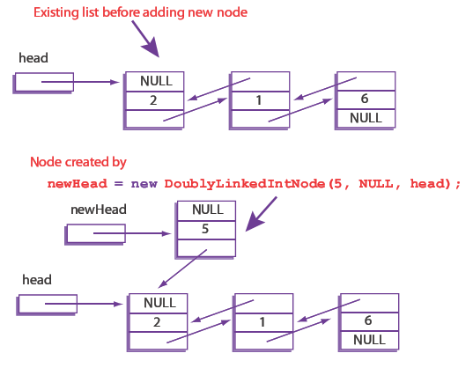
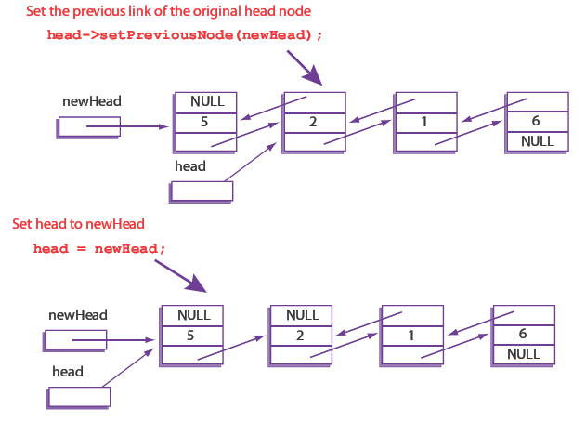
Maintaining Double Linked List
Each node now has 2 pointers
2) Update old head back ptr to new head
3) Reset the actual head
1) Allocate new head

Slide 35
Doubly Linked Lists
class DoublyLinkedIntNode
{
public:
DoublyLinkedIntNode ( ){}
DoublyLinkedIntNode (int theData, DoublyLinkedIntNode* previous,
DoublyLinkedIntNode* next)
: data(theData), nextLink(next), previousLink(previous) {}
DoublyLinkedIntNode* getNextLink( ) const { return nextLink; }
DoublyLinkedIntNode* getPreviousLink( ) const { return previousLink; }
int getData( ) const { return data; }
void setData(int theData) { data = theData; }
void setNextLink(DoublyLinkedIntNode* pointer) { nextLink = pointer; }
void setPreviousLink(DoublyLinkedIntNode* pointer)
{ previousLink = pointer; }
private:
int data;
DoublyLinkedIntNode *nextLink;
DoublyLinkedIntNode *previousLink;
};
typedef DoublyLinkedIntNode* DoublyLinkedIntNodePtr;

Slide 36
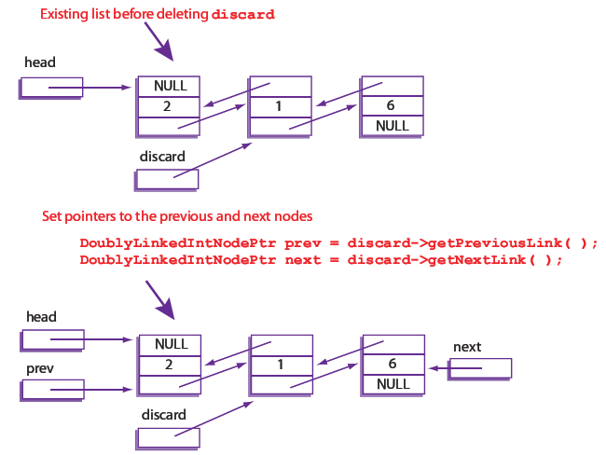
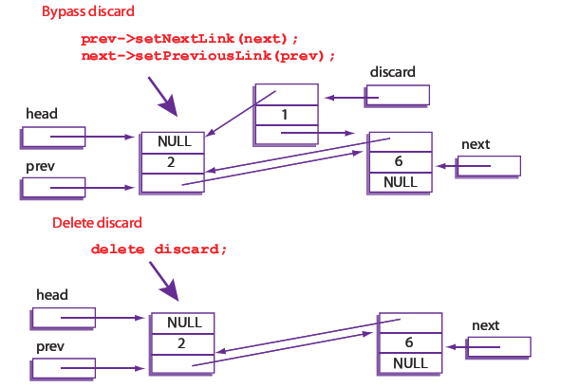
Deleting a Node from a Doubly Linked
Discard variable acts as a place holder
Delete frees up memory

Slide 37

Key Takeaways
Lists have the following components
Nodes
_________ for connection
Heads and optionally tails
Great for creating sorted lists of things
Insertion sort works great
Not as efficient as arrays but more dynamic and flexible

Slide 38
Destructors & Copy Constructors
Destructor: ~LinkedList()
Copy Constructor: LinkedList(LinkedList& l)

